Slide 1
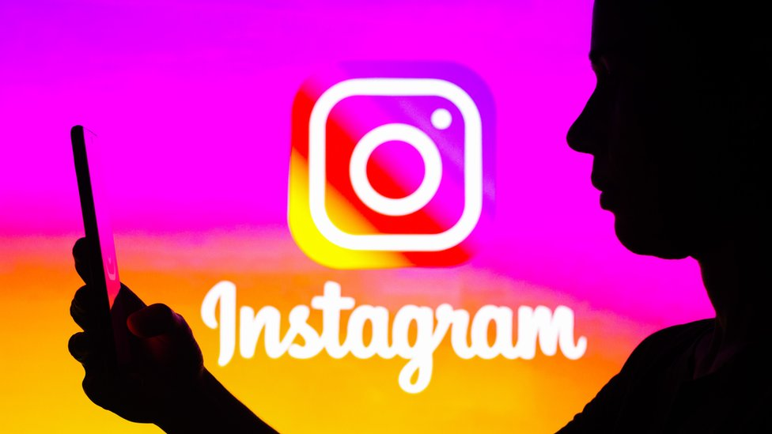
Social Media Analysis
Prashant Shandilya

Slide 2
Introduction
Objective
Collaborate with the Marketing team to utilize Instagram's user data.
Goal
Develop targeted marketing strategies to enhance user engagement, retention, and acquisition.

Slide 3
Importance of Social Media
Global Connectivity: Social media platforms connect billions of users worldwide, facilitating instant communication and information sharing across diverse communities.
Content Variety: From text and images to videos and live streams, social media supports a wide range of content formats, catering to varied user preferences.
Influence on Society: Social media shapes public opinion, trends, and cultural movements, playing a crucial role in modern societal dynamics and activism.
Business and Marketing: Companies leverage social media for brand promotion, customer engagement, and market research, making it a critical tool for digital marketing strategies.
Real-Time Interaction: Social media enables real-time interactions and feedback, fostering immediate user engagement and dynamic content creation.

Slide 4
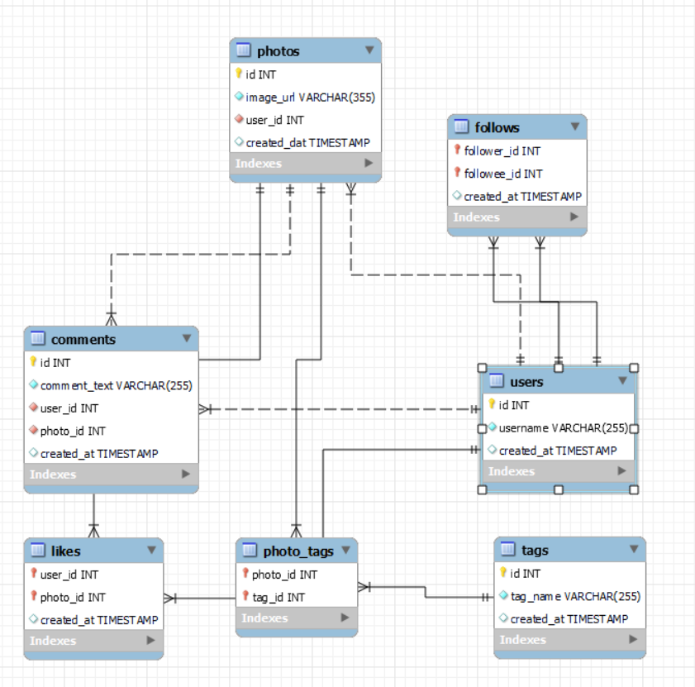
Database Schema

Slide 5
Data Analysis Workflow for Social Media Analysis
Data Collection
Data Cleaning and Preparation
Data Analysis
Visualization
Decision making

Slide 6
Data Description
Table | Description
Users | Contain user and time of user account creation
Photos | Contains Photo and user details
Likes | Contain user and photo details when photo is liked
Comments | Contain user and photo details when a cpmmented is written.
Tags | Contain the hashtags attached to a photo.
Photo_tags | Links the photo with the hashtag
Follows | Contains the follower_id and followee id for all users.

Slide 7
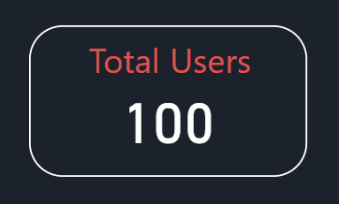
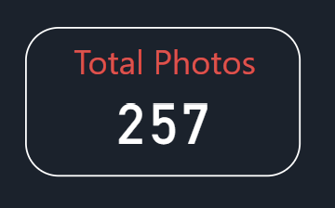
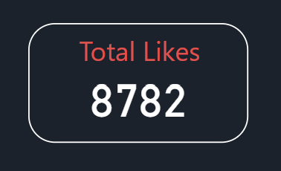
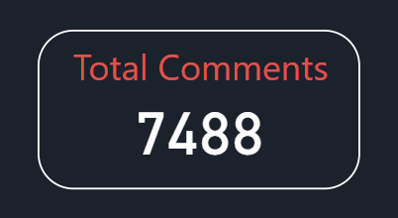
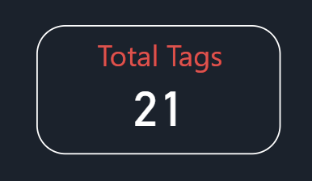
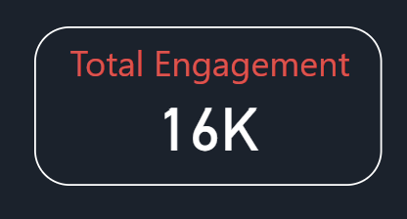
Data Insights

Slide 8
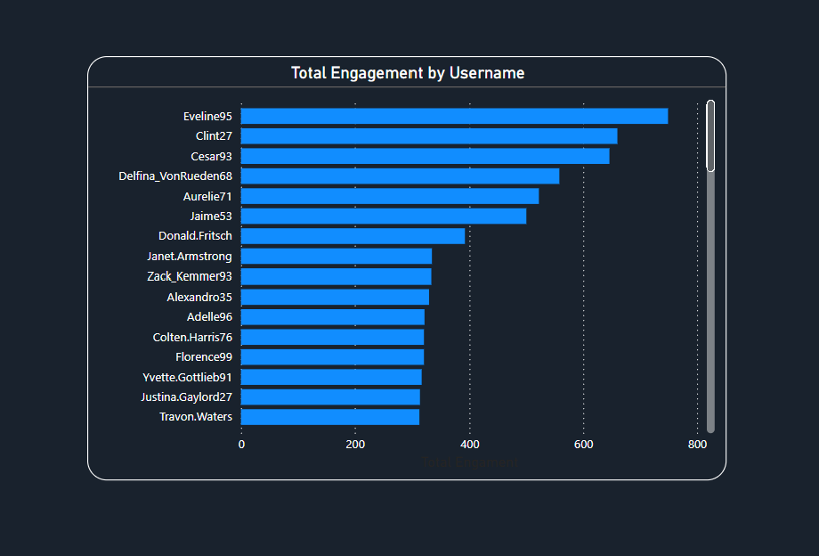
Total Engagement by Username

Slide 9
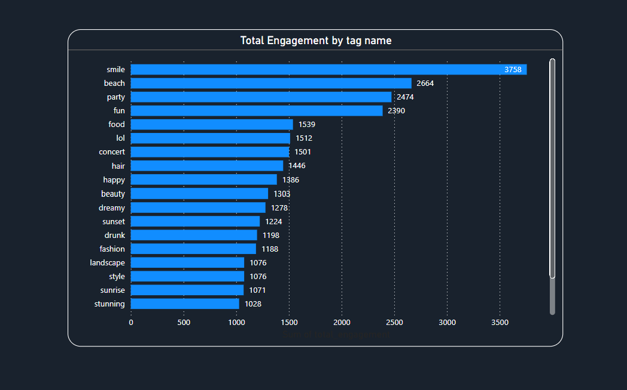
Total Engagement by Tag name

Slide 10
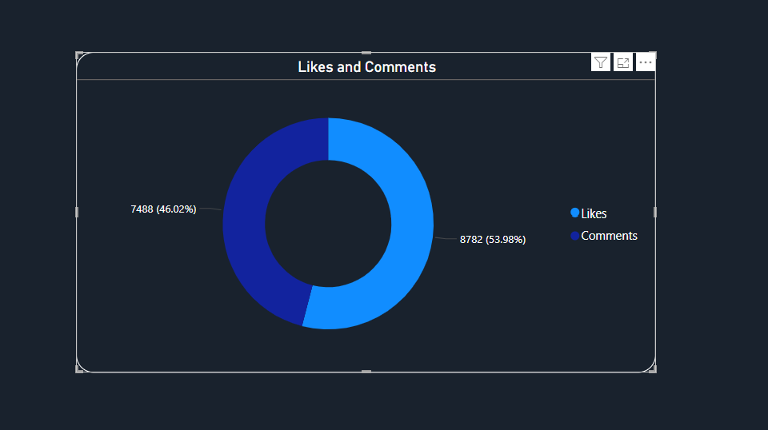
Likes and Comments

Slide 11
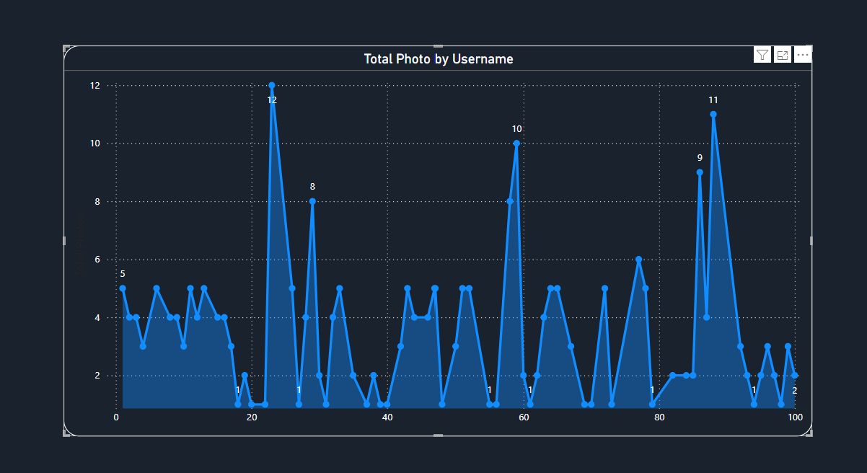
Total Photos by Username

Slide 12
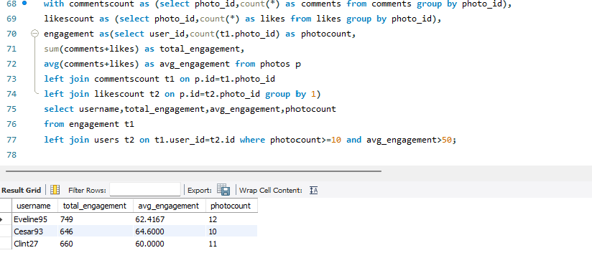
Selection Criteria and user selected
On analysing the user data, we can say that the below users can be selected as an potential brand ambassadors or advocates who could help promote Instagram's initiatives or events as they have posted the most pictures and have the highest engagement. The selected users are Eveline95, Cesar93 and Clint27

Slide 13
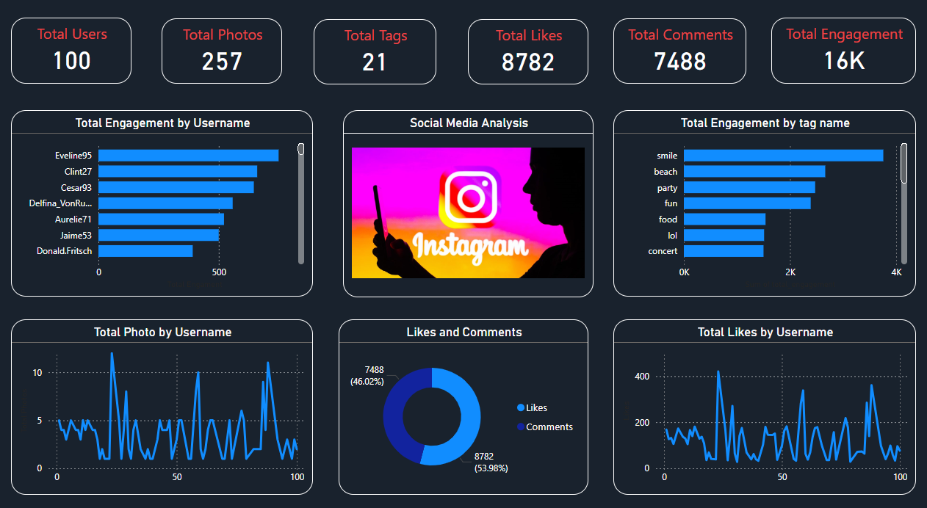
Social Media Analysis

Slide 14
Conclusion
Leveraging user data is crucial for effective marketing strategies.
Continuous monitoring and adaptation to market trends and customer feedback are crucial.
Tailored content and targeted campaigns drive engagement, retention, and acquisition..
Show that you are listening by implementing changes based on user feedback and communicating these changes.
Use in-app notifications to draw their attention to relevant updates or content they have previously shown interest in.

Slide 15


